Slide 1
Opening a new restaurant or a bar in Los Angeles

Slide 2
The main objective of this capstone project is to find out which areas are better suited and will be more profitable to open a new restaurant or a bar. This project can be useful for business owners and entrepreneurs as well who are looking to invest in a restaurant in Los Angeles. The main objective of this project is to carefully analyse appropriate data and find recommendations for the stakeholders.

Slide 3
The data of the neighbourhoods of Los Angeles was scrapped from https://en.wikipedia.org/wiki/List_of_districts_and_neighborhoods_in_Los_Angeles . The data is read into a pandas data frame using the Beautifulsoup library. The main reason for doing so is that the Wikipedia page provides a comprehensive and detailed table of the data which can easily be scraped using the Beautifulsoup library of python.
For geolocation data, we will use the Geocoding API.
The venue data has been extracted using the Foursquare API. This data contains venue recommendations for all neighbourhoods in Los Angeles and is used to study the popular venues of different neighbourhoods.

Slide 4
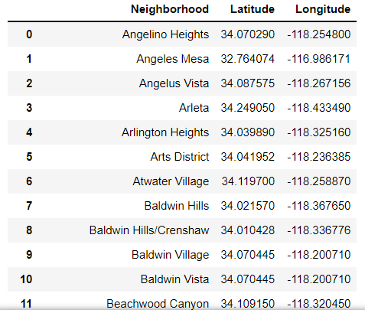
We get the list of neighbourhoods in LA by scraping the data from https://en.wikipedia.org/wiki/List_of_districts_and_neighborhoods_in_Los_Angeles which is a Wikipedia page about neighbourhoods in LA. Using Geocoding API, we get the latitudes and longitudes of the location. We parse the data from the Wikipedia page using Beautifulsoup library of Python. There are total 200 neighbourhoods in Los Angeles.

Slide 5
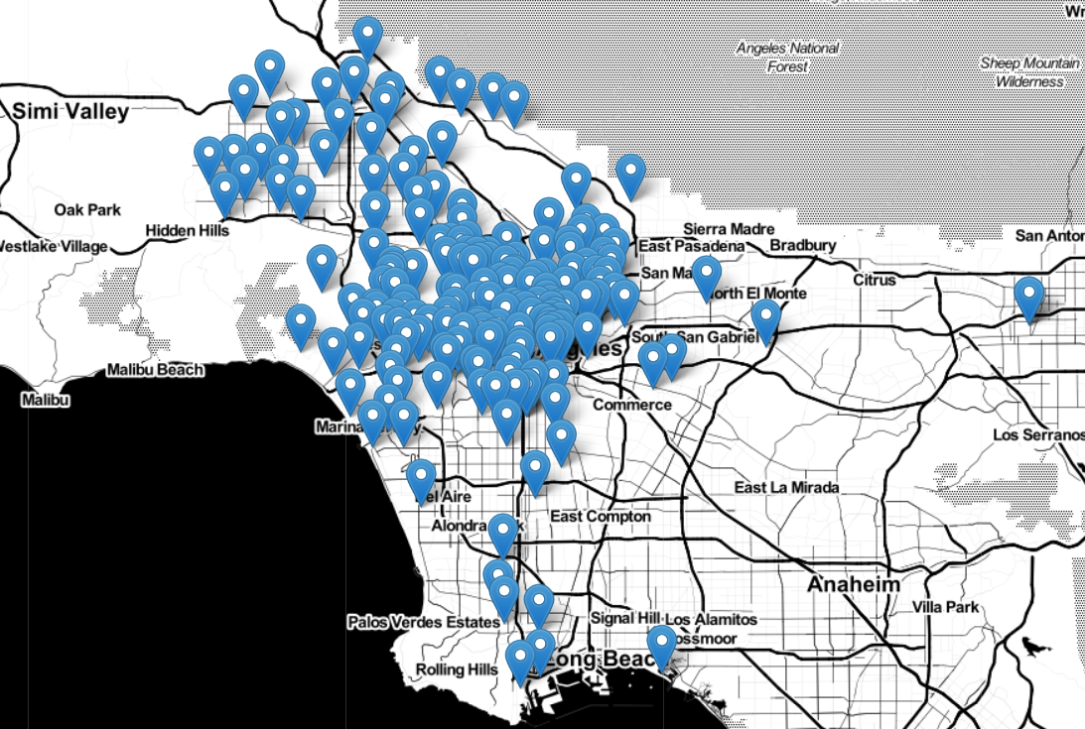
Using Folium, we can plot these neighbourhoods on a map.

Slide 6
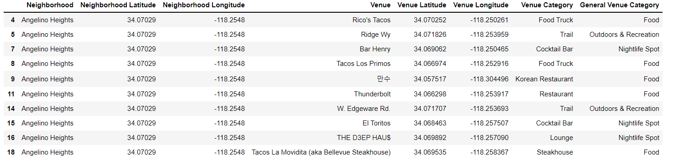
We then use the Foursquare API to get the data of venues. These venues are divided into many categories such as Arts and Entertainments, Travel and Transport, Professional and other places etc. Since we are looking to open a restaurant or a bar, we are only going to select three categories – Food, Outdoor and Recreation, and Nightlife Spot.

Slide 7
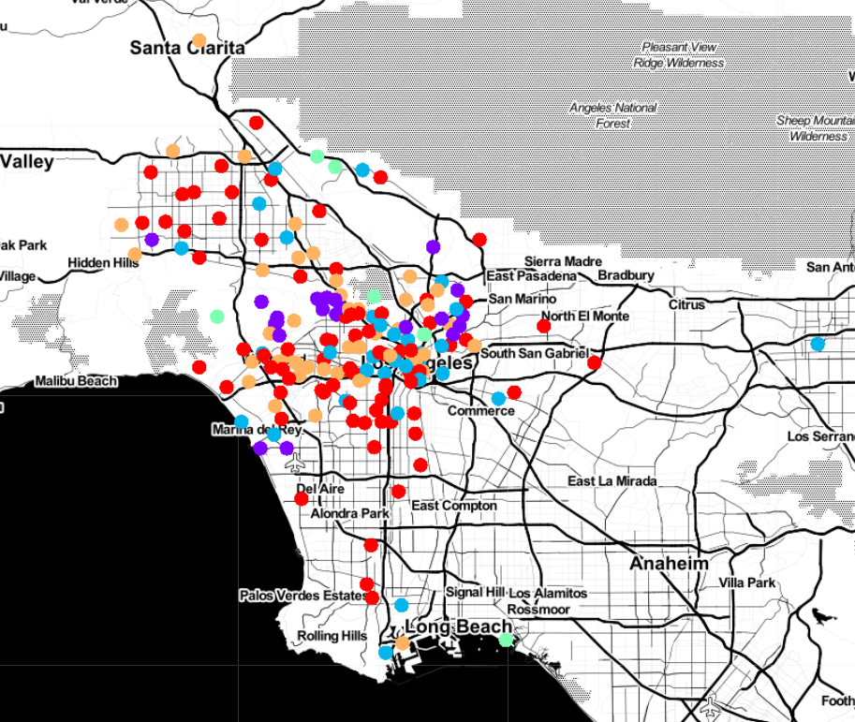
As we can see, there are total 3545 venues in Food category, 1408 in Outdoors and Recreation category and 815 in Nightlife spot category. After clustering these venues into 5 clusters using k-means and plotting them on the map, we get the following map:

Slide 8
Results and Discussions:
All venues are grouped into five clusters
Cluster 1 has the most number of neighbourhoods (82) and Cluster 4 has the least number of neighbourhoods (6).
“Food” venue category is the most popular category in Cluster 1,3 and 5 whereas “Outdoor and Recreation” is the most popular category in Cluster 2 and 4.
Food seems to be the most popular category followed by Outdoor and Recreation.

Slide 9
Conclusions:
In this project, we analysed the neighbourhoods in Los Angeles. We get the list of neighbourhoods in LA by scraping the data from the Wikipedia page about neighbourhoods in LA. Using Geocoding API, we get the latitudes and longitudes of the location and Folium helps us to plot these neighbourhoods on a map
We then used the Foursquare API to get the data of venues and divided them into five clusters. Finally, we plotted them on the map.

